Slide 1
The New York State Dignity for all Students Act (DASA)
PTA Council Presentation
December 12, 2012
Notes:
Before the presentation begins
Distribute the hand-outs
Check projector and sound equipment
Determine the lighting so audience can see the slides and movie clips
Set up room for pair/share or small group sharing (if auditorium use turn and talk)
Leave slide on as participants get settled
Greet participants as they enter the venue
Facilitator introduces him/herself
Say: The New York State Dignity Act requires that every person in a school setting be trained in awareness about bullying prevention and intervention. The law requires that each school building in the state assign a Dignity Act Coordinator.
___________________________ is the Dignity Act Coordinator at our school.
We have a two part presentation for you, presented by Karen Siris, principal of
WS Boardman Elementary School in Oceanside, and a member of the New York State Dignity Act Task Force as the School Administrators’ of New York (SAANYS) representative. There will be some participation from the group and we will pause the film at those times. We will see Part I today and Part II at our next meeting.

Slide 2
DASA and Task Force on Bullying Prevention Steering Committee
Members consisting of:
Central Office Administrators
School Administrators
Teachers
Support Staff
Pupil Personnel Staff
Parents and Community Members
Law Enforcement

Slide 3
Major Goals/Initiatives
Organize and plan district-wide staff training
Organize and plan school-based DASA Team training
Update district policy and student Code of Conduct
Create a “DASA culture”
Foster “common language”
Facilitate the creation of “student friendly” versions of the code of conduct

Slide 5
POB CARES!
K-Center - COMMUNITY
Old Bethpage Elementary - ACCEPTANCE
Parkway - RESPECT
Pasadena - EDUCATION
Stratford - SENSITIVITY
POBMS, Mattlin, and POBJFKHS – EXAMPLES OF POB CARES IN ACTION

Slide 6
POB CARES!
Video Clip
http://www.pobschools.org//Domain/1

Slide 7
WELCOME
DIGNITY ACT OVERVIEW
WHAT IS BULLYING?
COMMON LANGUAGE
WHERE DO WE GO FROM HERE?

Slide 8
Why Should We CARE?
NYS and Change: The Perfect Storm.
Bullying takes place in every school every day.
The research is clear that when students feel safe at school, they perform at a higher level.
Notes:
Before this video, the audience is asked to make a personal connection to bullying and harassment. The connection can be through
their own experiences in elementary, middle or high school
the experiences of their own children
the experiences of children in their school setting
Optional…. A turn and talk can take place after viewing the clip, or volunteers may want to share their own stories with the group.

Slide 9
Why have 48 states passed anti-bullying/harassment laws? (GLSEN, 2010)
39% of students reported that bullying, name calling, and harassment pose a serious problem at school.
66% reported that people at school were harassed at least “sometimes” because of their looks or body size.
57% reported that students were bullied or harassed “sometimes” because of the way they expressed their gender.
No Law in South Dakota and New Mexico

Slide 10
What the kids say….
(Josephson School of Ethics, 2010
43,000 students surveyed)
50% of high school students (2010) admit they bullied someone in the past year.
47% admit that they were bullied, teased or taunted in a way that seriously upset them in the past year.

Slide 11
New York Law THE LAW
Requires districts and schools to prevent, monitor, and address bullying through: (July, 2012)
Designation of a Dignity Act Coordinator to be trained in non-discriminatory instructional and counseling methods and in handling human relationships.
Staff training to raise awareness and sensitivity of school employees to issues of harassment and discrimination.
Sensitivity and tolerance curricula for students.
Revising the code of conduct to create a school environment free from harassment and discrimination .
Reporting of bullying incidents to the state through designated reporting system .

Slide 12
New York State Assembly CYBERBULLYING LAW SIGNED by Governor Cuomo on July 9, 2012 GOES INTO EFFECT 7/2013
Requires all school staff to report any incident of bullying
AND CYBERBULLYING
to the school principal or superintendent
“Cyberbullying has become a dangerous trend and this legislation gives parents and students the tools needed to overcome it,” said Zebrowski. “Standardized policies and procedures will guide teachers and school staff so that they are better equipped to respond to harassment and bullying within the classroom and beyond.” Assemblyman Kenneth Zebrowski (D- New City, NY)

Slide 13
CYBERBULLYING (Stomp Out Bullying, 2010)
58% of kids say someone has said mean or hurtful things to them online.
53% of kids admit saying something mean or hurtful to another person online.

Slide 14
The New York Law: The Dignity Act
The Dignity for All Students Act prohibits harassment with respect to certain non-exclusive protected classes including, but not limited to:
actual or perceived race
color
weight (physical characteristics)
national origin
ethnic group
religion
religious practice
disability
sexual orientation
perceived sexual orientation
sex
(N.Y. Educ. Law §§10-18, 801-a)

Slide 15
Dignity Act and
Student Curriculum & Instruction
Requires classroom instruction and curricular connections in the following areas:
Civility
Citizenship
Character
Honesty
Tolerance
Personal Responsibility
Respect for Others
Dignity for All
Notes:
Say: We have many of these traits and attributes in our curriculum now. We do not have to reinvent the wheel, but we do need to make sure that what we are doing now through literature , social studies, health, character education, assembly programs, are identified as supporting the DIGNITY ACT.
Turn and talk about what comes to mind that is in our curriculum.
Do we need to supplement any aspect of this list?

Slide 16
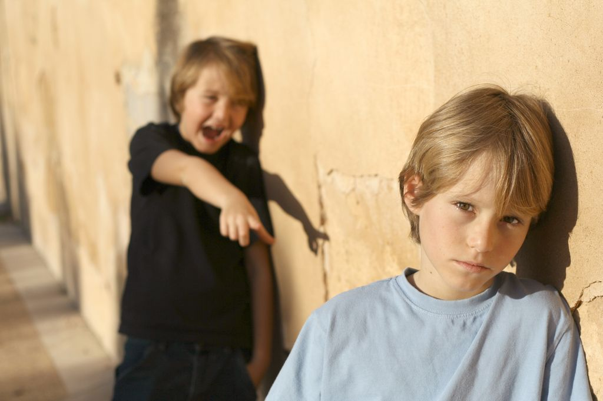
Bullying is a type of harassment
An intentional act of aggression, based on an imbalance of power, that is meant to harm a victim either physically or psychologically.
Usually occurs repeatedly and over time, however sometimes can be identified in a single event.

Slide 17
TYPES OF BULLYING BEHAVIORS
PHYSICAL
Hitting, punching, tripping
Kicking, pushing, scratching
Damaging/stealing property
VERBAL
Name calling, teasing, taunting
Making offensive remark
Making discriminatory remarks
Verbally threatening, intimidating
SOCIAL/EMOTIONAL/RELATIONAL
Excluding or threatening to exclude
Spreading rumors, gossiping
Ostracizing, alienating
Using threatening looks or gestures
Extortion
CYBERBULLYING
Use of the internet or cell phone to harass and intimidate

Slide 18
What We Can Do
Implement bullying prevention and intervention strategies that fit each school’s culture.
Run workshops for parents so that they can support and use the same common language in the home.
Implement our district policy that prevents and intervenes in all forms of bullying, cyberbullying and harassment.

Slide 19
HOW?
Commit to training all constituents of the school community in prevention and intervention strategies.
Establish a Dignity Act Team at each school building level to insure adherence to the district policy.

Slide 20
Dignity Act Team
Who: Principal, mental health professionals, school counselors, teachers, non-teaching staff (aides, bus drivers, custodians).
What: Create a bully intervention plan that includes methods for prevention and intervention.

Slide 21
Developing Common Language
THE BULLY
THE TARGET/VICTIM
THE BYSTANDER
THE UPSTANDER

Slide 22
A person who intervenes when s/he witnesses intolerance; someone who makes a stand against bullying.
Upstander

Slide 23
Adults Can and Do Make A Difference
The research shows that where bullying is not an issue, EVERY child has at least one adult that they feel comfortable talking to.
Work to be that one person!
POB CARES!!!

Slide 24
Thank-you for your attention and help in ending bullying and harassment in our schools.

